Slide 1

Saudi Electricity Company Business Process
Student’s Name
Institution of Affiliation
Date

Slide 2
Introduction
Business processes are critical assets for any company or organization. They guide the organization towards achieving its objectives. Business processes are specific, purposeful, and have consistent outcomes. While they are important assets to any organization and may occur at all levels, sometimes they may not be visible to the organization's users or customers. The business environment is dynamic, meaning it undergoes constant changes; when it does organization must also undergo transformation to keep abreast with these changes or risk being obsolete.
As organizations undergo these changes to fit into the evolving business environment, it is the business processes that are affected, which in turn, impact process enablers. This report provides an in-depth analysis of two processes implemented by the Saudi Electricity Company. These two processes are Governance, risk management, and compliance, and business planning and consolidation.
Notes:
Business processes are critical assets for any company or organization. They guide the organization towards achieving its objectives. Business processes are specific, purposeful, and have consistent outcomes. While they are important assets to any organization and may occur at all levels, sometimes they may not be visible to the organization's users or customers. The business environment is dynamic, meaning it undergoes constant changes; when it does organization must also undergo transformation to keep abreast with these changes or risk being obsolete.

Slide 3
Overview of Saudi Electricity Company
Saudi Electricity Company (SEC) is a publicly listed Saudi Arabian power company that generates, transmits and distributes electric power in Saudi Arabia. The company was formed in 2000 through amalgamation of local electricity companies in Saudi Arabia to form one joint stock company
The company is the Gulf region largest utility by market values enjoying dominance in electric energy generation, transmission and distribution across Saudi Arabia through its 45 power generation plants.
SEC generates more than $17 billion in annual sales making it one of the largest companies in the Kingdom of Saudi Arabia and the world ("Company Information", 2021).
In 2009 The Electricity and Cogeneration Regulatory Authority (ECRA) announced its intention to break SEC into separate generation, distribution and transmission companies to encourage competition in energy sector. This split led to the establishment of the National Grid SA in 2012, a transmission company operating on the national grid.
Notes:
Saudi Electricity Company (SEC) is a publicly listed Saudi Arabian power company that generates, transmits and distributes electric power in Saudi Arabia. The company has it headquarters in Riyadh, Saudi Arabia. Saudi Electricity Company was formed in 2000 through amalgamation of local electricity companies in Saudi Arabia to form one joint stock company. 81.22% of the company is owed the the government of the kingdom of Saudi Arabia ("Company Information", 2021). SEC generates more than $17 billion in annual sales making it one of the largest companies in the Kingdom of Saudi Arabia and the world ("Company Information", 2021).

Slide 4
Literature Review
Today’s business environment present unparalleled busines and regulatory impediments coupled with disruptive technologies.
Organizations need innovative and proactive GRC strategies to meet their stakeholder’s expectations and get hold of available competitive opportunities.
In today’s business environment, technology plays a more critical role in creating, shaping and influencing new business models compared to traditionally when it was just a facilitator for implementing business models. Business are the forefront at experiencing the influence of technology (Wiedenhoft, Luciano & Magnagnagno, 2017).
Technology enables functions such as governance, risk management and compliance to use it to enhance their contribution and value proposition besides influencing core business processes (Miller, 2017).

Slide 5
Literature Review (Continuation)
Governance, risk management and compliance are essential aspects in organizations that help achieve their business goals and objectives. They involve actions and processes established, approved and implemented by the company’s board of directors and facilitated through the company’s structure to drive it towards achieving its goals.
Risk management encompasses identifying, assessing and managing risks impeding the company’s achievement of its business goals and objectives.
The compliance aspects ensures that the company has internal controls and process to meet regulations, standards and was by regulators, government bodies, policies and industry mandates.
The effectiveness of the governance, risk management and compliance (GRC) function is ensuring companies meet their business objectives. Technology enhances their ability to achieve these objectives in a compliant and well managed environment.

Slide 6
Literature Review (Continuation)
Technology enhances their ability to achieve these objectives in a compliant and well managed environment.
Demand for electric power energy continues to increase and is expected to continue rising into the future due to a growing population, expanding industrial base, and increasing per capita consumption.
The Saudi Electricity Company's primary objective is the generation and provision of safe, cost-efficient, and reliable electric power to end-users. This aligns with the Kingdom of Saudi Arabia's government policy of developing the electricity sector of the country.
SEC's integration of technology into its operations propels the company's growth. All management levels are compelled to act in line with principles of Governance, risk, and compliance.
Notes:
Saudi Electricity Company enjoys a monopoly of the gulf region market with a peak load of over 60000 megawatts. Demand for electric power energy continues to increase and is expected to continue rising into the future due to a growing population, expanding industrial base, and increasing per capita consumption

Slide 7
Literature Review (Continuation)
The Saudi Electricity Company's use of SMART GRC enables them to monitor their action and process and ensure they are compliant, and work towards achieving its overall goal.
The Saudi Electricity Company's implementation of the integrated SMART GRC helps it streamline its business operations and enhance its function. The use of multiple fragmented systems can cause confusion; therefore, an integrated SMART GRC reduces unnecessary actions and helps the company focus on the processes that lead to the achievement of the overall goal.
SEC's use of a single integrated system has improved the company's organization as it has a single process that serves as a central reference point for its business operations.
Notes:
In business, one can be hard-pressed to find a solution that addresses challenges for all organizations. An integrated GRC and other software tools can be important in company processes and activities that require significant organizational input. The Saudi Electricity Company's implementation of the integrated SMART GRC helps it streamline its business operations and enhance its function.

Slide 8
Analysis of Model, Technology
Governance, Risk Management and Compliance (GRC)
Saudi Electricity Company's approach to Governance, risk management, and compliance (GRC) has consistently grown to be more strong and comprehensive.
The company is committed to adhering to local regulatory guidelines and international industry standards.
Saudi Electricity Company's corporate governance framework hinges on the provisions of regulations provided by the companies law, the Electricity and Cogeneration Regulatory Authority (ECRA) and the Capital Market Authority of Saudi Arabia, and Saudi Electricity Company's Articles of Association.
The company's internal control measures and risk management efforts that focus on protecting shareholders' and other stakeholders' rights are essential to GRC.
Notes:
Saudi Electricity Company's approach to Governance, risk management, and compliance (GRC) has consistently grown to be more strong and comprehensive. The company is committed to adhering to local regulatory guidelines and international industry standards. Saudi Electricity Company's corporate governance framework hinges on the provisions of regulations provided by the companies law, the Electricity and Cogeneration Regulatory Authority (ECRA) and the Capital Market Authority of Saudi Arabia, and Saudi Electricity Company's Articles of Association.

Slide 9
Process Introduction
Business processes are structured tasks or activities performed by an organization to achieve its goal of providing a product or service to its customers
The Governance, risk management, and compliance process is an organized approach to aligning the company's business model and objectives at the same time managing risk effectively and complying with regulatory standards and requirements.
Governance involves procedures and activities approved and undertaken by the executive to support the company's business goals and objectives.
Risk management involves identifying and addressing risks associated with the company's activities and could be an impediment to achieving its goals.
Compliance entails ensuring the company's activities and operations fall within the regulations and mandated laws affecting systems.
Notes:
Business processes are structured tasks or activities performed by an organization to achieve its goal of providing a product or service to its customers. The Governance, risk management, and compliance process is an organized approach to aligning the company's business model and objectives at the same time managing risk effectively and complying with regulatory standards and requirements.

Slide 10
Technology in Use
The integration of risk management systems within a company's operational and strategic decision-making process is integral to its success in business.
Corporate Governance is a significant aspect of enterprise risk management in the modern business world as logical business practices impact the company's level of security (Ali, 2020).
Saudi Electricity Company audit committee oversights its financial affairs on behalf of the board for the interest of the company's shareholders.
Saudi Electric Company settled on the SMART GRC suite for audit and assessment issues, risk management tracking, and compliance.

Slide 11
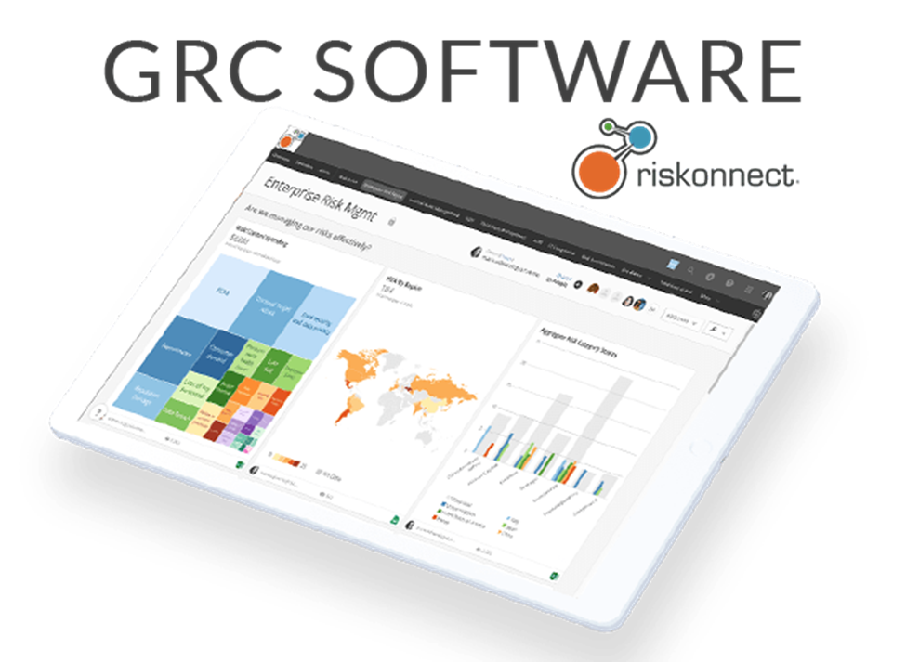
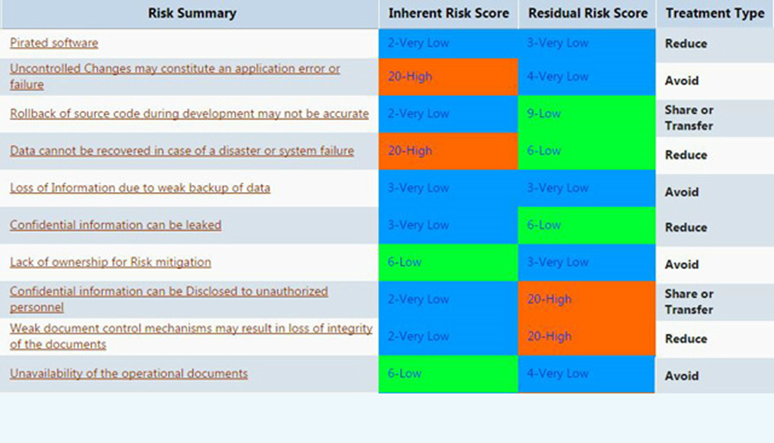
Technology in Use (Continuation)
SMART GRC tool enables the company to enhance the productivity of its audit team through analysis and unification of audit data from various departments in a fast and efficient manner.
Notes:
Saudi Electric Company settled on the SMART GRC suite for audit and assessment issues, risk management tracking, and compliance. SMART GRC tool enables the company to enhance the productivity of its audit team through analysis and unification of audit data from various departments in a fast and efficient manner. SMART GRC suite has automated reporting of compliance and risk management activities as well as documentation.

Slide 12
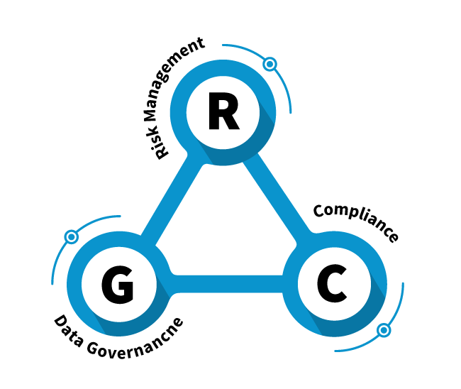
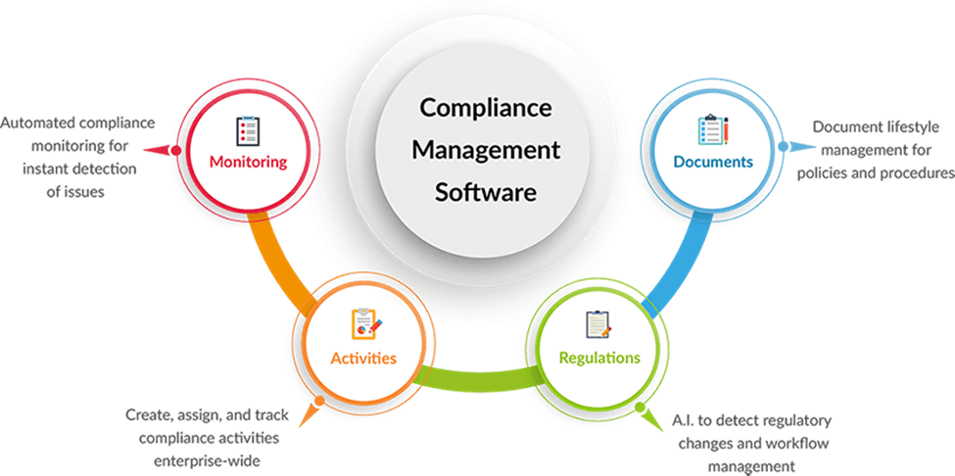
System Architecture
The system architecture describes the behavior and structure of a system. The system architecture for the SMART GRC software tool is presented as follows.
It covers Governance, risk management, and compliance.
Notes:
The system architecture describes the behavior and structure of a system. The system architecture for the SMART GRC software tool is presented as follows. It covers Governance, risk management, and compliance.

Slide 13
Process Explanation
It is increasingly becoming challenging and expensive for companies to comply with multiple often overlapping regulations, laws, and standards.
SMART GRC provides Saudi Electricity Company with an integrated platform with solutions that upholds the company's business and performance objectives while reducing risks.
The company's approach to the GRC process is based on the principle of getting their activities and procedures right and maintaining them.
SEC GRC framework identifies measurables that focus on the effectiveness of the company's GRC efforts. The framework provides the foundation on which the company can shape or influence its environment.
Notes:
It is increasingly becoming challenging and expensive for companies to comply with multiple often overlapping regulations, laws, and standards. SMART GRC provides Saudi Electricity Company with an integrated platform with solutions that upholds the company's business and performance objectives while reducing risks.

Slide 14
Process Explanation (Continuation)
SMART GRC enables SEC to create and coordinate control and policies and align them to internal and regulatory compliance requirements.
The software tool is cloud-based and has enabled automation of many of the company's actions and processes therefore increasing its efficiency and minimizing complexity.
The implementation of the integrated SMART GRC in the company has significant benefits, including;
Automation of documentation
The software tool provides whole round visibility in the audit metrics and processes that help in better compliance to regulatory requirements and risk management.
It automates actions, progress, and notification to ensure compliance.
SMART GRC presents a ready-to-use dashboard with custom reports
Notes:
SMART GRC enables SEC to create and coordinate control and policies and align them to internal and regulatory compliance requirements. The software tool is cloud-based and has enabled automation of many of the company's actions and processes therefore increasing its efficiency and minimizing complexity

Slide 15
The Process Workflow
The world is constantly evolving and changing. Things that were thought not to happen have happened, and those that were expected to occur did not.
Risk management has become an important aspect in organization operations spanning geographical and corporate boundaries. The purpose of Governance, risk management, and compliance (GRC) is to minimize costs, risks, and the duplication of actions and effort.
GRC requires corporations across the board to accomplish results that meet internal processes and guidelines established for the elements of Governance, enterprise risk management, and compliance (Harper, 2020)
Notes:
The world is constantly evolving and changing. Things that were thought not to happen have happened, and those that were expected to occur did not. Risk management has become an important aspect in organization operations spanning geographical and corporate boundaries. The purpose of Governance, risk management, and compliance (GRC) is to minimize costs, risks, and the duplication of actions and effort. GRC requires corporations across the board to accomplish results that meet internal processes and guidelines established for the elements of Governance, enterprise risk management, and compliance (Harper, 2020

Slide 16
The Process Workflow (Continuation)
The integrated SMART GRC is designed to automate complex workflow processes. The software tool allows the company to obtain required by the board on the acceptable levels of segregation of duties risks with access to business processes and applications.
The SMART GRC empowers Saudi Electricity Company to;
Increase control and transparency of the entire business process.
Full automation of the company's actions and processes.
Automatically implement requestion in the SAP system.
Minimize unnecessary iterations.
Notes:
The software tool allows the company to obtain required by the board on the acceptable levels of segregation of duties risks with access to business processes and applications.

Slide 17
Process Analysis
GRC takes an organized approach to aligning company processes with its objectives while managing risk and ensuring compliance requirements and standards are met.
SEC's implementation of GRC software helps the company automate documentation, compliance activities, and risk management.
GRC process is critical in audit, compliance, risk, and policy management. SEC shift towards a more integrated solution encompassing numerous aspects of GRC provides the company's management with the software's significant influence on the company.
Notes:
Over the years, there has been an upward trend in companies' automation of their GRC actions and processes through internal customized systems or integrated third-party GRC softwares. GRC takes an organized approach to aligning company processes with its objectives while managing risk and ensuring compliance requirements and standards are met. SEC's implementation of GRC software helps the company automate documentation, compliance activities, and risk management.

Slide 18
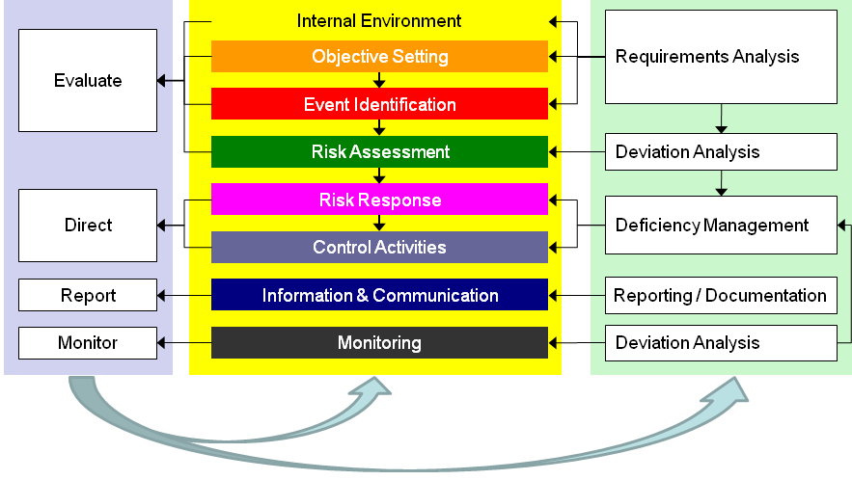
Process Analysis
As SEC evaluates its data needs and current risk information, the company's executives and management find it beneficial to work IT functions to build and enhance the GRC's support system. The application of the GRC software in the company's information technology governance process ensures management's need for risk management information is included in the company's information management strategy.
Notes:
As SEC evaluates its data needs and current risk information, the company's executives and management find it beneficial to work IT functions to build and enhance the GRC's support system. The application of the GRC software in the company's information technology governance process ensures management's need for risk management information is included in the company's information management strategy.

Slide 19
Analysis of Model, Technology
Business Planning and Consolidation
SAP business planning and consolidation (BPC) is a module that supports an organization's financial and operational activities.
SAP BPC provides planning, forecasting, budgeting, and financial, management, and legal consolidations. Additionally, it offers a single view of operational and financial data and a merged solution backing performance management processes, for instance, forecasts, adjusting the plan, closing cycles, and enhancing the budgeting process.
The tools streamline planning, budgeting, forecasting, and consolidation, therefore, improving the organization's decision-making process.
SAP BPC encompasses business process flows that organizations can use as formal workflows for operational and financial processes
Notes:
SAP business planning and consolidation (BPC) is a module that supports an organization's financial and operational activities. SAP BPC provides planning, forecasting, budgeting, and financial, management, and legal consolidations. Additionally, it offers a single view of operational and financial data and a merged solution backing performance management processes, for instance, forecasts, adjusting the plan, closing cycles, and enhancing the budgeting process.

Slide 20
Process Introduction
SAP Business Planning and Consolidation (SAP BPC) is a tool providing organizations with planning, budgeting, forecasting, and consolidating capabilities.
The software tool supports an organization's financial and operational activities. It enables organizations ta address the challenging and long process of data collection and validation across comprehensive and complex systems.
SAP BPC is used by organizations to enhance financial planning, budgeting, financial reporting, and consolidation while minimizing compliance risk (Huang et al., 2018).
Notes:
SAP Business Planning and Consolidation (SAP BPC) is a tool providing organizations with planning, budgeting, forecasting, and consolidating capabilities. The software tool supports an organization's financial and operational activities. It enables organizations ta address the challenging and long process of data collection and validation across comprehensive and complex systems.

Slide 21
Technology in Use
Saudi Electricity Company is without a doubt the largest power utility company in Saudi Arabia, and like many other organizations, it involves numerous operational processes as it provides energy to its customers.
The advent of technology and the changing business environment have resulted in the company's integration of technology in its operational process.
Saudi Electricity Company has implemented the use of SAP BPC software as a significant solution of EPM suite.
The software tools help the company to exploit the value of their existing data sets. BPC provides the company access to real-time and dependable corporate data in addition to streamlining its financial planning and consolidation processes.
). BPC's comprehensive approach allows the company to effectively manage risk, optimize business profitability and ensure compliance while maximizing corporate processes, systems, and people.
Notes:
Saudi Electricity Company is without a doubt the largest power utility company in Saudi Arabia, and like many other organizations, it involves numerous operational processes as it provides energy to its customers. Just like many organizations, SEC faces significant challenges that affect its ability to perform its role and achieve its goal. The advent of technology and the changing business environment have resulted in the company's integration of technology in its operational process.

Slide 22
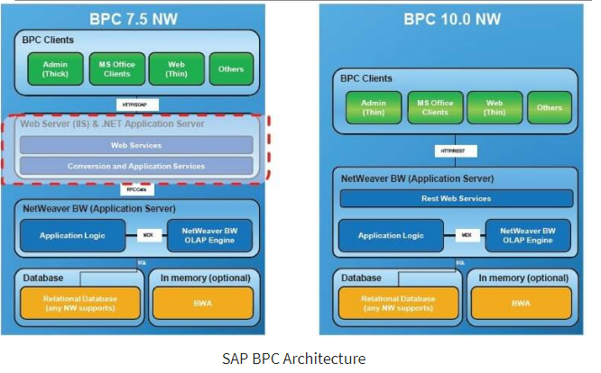
System Architecture
SAP BPC uses various script logics and business rules to perform its functionalities. The core components of the BPC system architecture are presented as follows.
Notes:
SAP BPC uses various script logics and business rules to perform its functionalities.

Slide 23
System Explanation
SAP BPC software tool connects SAP and non-SAP data with integrated functionalities to enhance the company's close.
BPC enables fast and reliable financial close, lowers auditing costs and compliance, therefore, enhancing stakeholder confidence. Additionally, it enhances the company's data through its central data repository.
BPC has consolidation capability functionalities that support the company's legal, statutory, and management consolidations (La Rosa et al., 2013).
SAP business planning and consolidation offer a comprehensive database with strong performance through an integrated ERP system, SAP S/4HANA.
Saudi Electricity Company has integrated this software tool into its planning and operation process, therefore, allowing for the incorporation of financial operations, overarching strategy, and performance process.
Notes:
SAP BPC software tool connects SAP and non-SAP data with integrated functionalities to enhance the company's close. BPC enables fast and reliable financial close, lowers auditing costs and compliance, therefore, enhancing stakeholder confidence. Additionally, it enhances the company's data through its central data repository. BPC has consolidation capability functionalities that support the company's legal, statutory, and management consolidations (La Rosa et al., 2013). The tool complies with financial reporting standards and requirements, including GAAP.

Slide 24
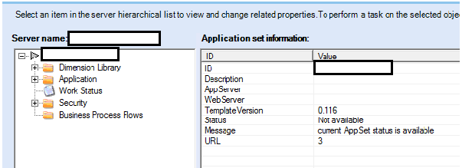
The Process Workflow
BPC allows the organization to set up tasks and maintenance for BPC clients.
The software has two interfaces that are the web interface and the client application. The user selects the BPC software to start and selects the task to be completed.
The user creates new dimensions which represent entities of business, for instance, the company category, codes, and accounts.
Notes:
BPC allows the organization to set up tasks and maintenance for BPC clients. The software has two interfaces that are the web interface and the client application. The user selects the BPC software to start and selects the task to be completed.

Slide 25
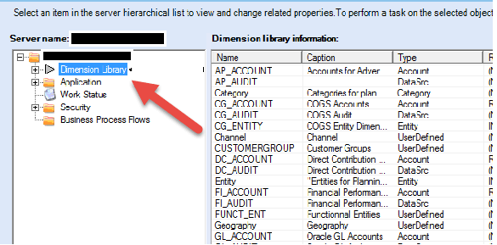
Process Analysis
SAP BPC supports the company's operational and financial planning requirements. Additionally, the tool manages the company's consolidation processes within a unified application. This unified and flexible solution allows SEC to focus more on strategic business and growth.
Notes:
SAP BPC supports the company's operational and financial planning requirements. Additionally, the tool manages the company's consolidation processes within a unified application. This unified and flexible solution allows SEC to focus more on strategic business and growth.

Slide 26
Recommendations
Saudi Electricity Company, over the years, has made a significant improvement in terms of business practices and strategies which have been a driving force behind the company's success.
The human nature to technology to regulatory compliance and market variability, the prospects of risks and uncertainty exist nearly everywhere and in almost everything. Even so, is the ability to identify and effectively create a distinction between creating value and those that lead to success can only be achieved through a company's proactive approach.
In today's business environment, being a risk-minded organization is critical as there is more at risk, and losses could be catastrophic.
For the Saudi Electricity Company, an effective GRC program helps generate and preserve value as well and driving the company's performance improvements. Having effective GRC and SAP BPC programs should be the main focus of any organization, especially its management, as lack of support impedes progress.

Slide 27
Recommendations
Business processes are core assets to any organization. The organization to achieving its desired goal. This report has provided an analysis of two processes implemented by Saudi Electricity Company. This business process increases the company's flexibility in the changing business environment. SEC has well-organized management that ensures effective operational processes that have resulted in the company's business success. The implementation of various business process softwares, including SMART GRC and SAP BPC, enables the organization to execute the model, monitor and maximize its processes.
Notes:
Business processes are core assets to any organization. The organization to achieving its desired goal. This report has provided an analysis of two processes implemented by Saudi Electricity Company. This business process increases the company's flexibility in the changing business environment. SEC has well-organized management that ensures effective operational processes that have resulted in the company's business success. The implementation of various business process softwares, including SMART GRC and SAP BPC, enables the organization to execute the model, monitor and maximize its processes.

Slide 28
References
Ali, H. M. (2020). Corporate governance developments in the Saudi Arabia and Malaysia. UUM Journal of Legal Studies, 10(1), 185-214.
Company Information. Saudi Electricity Company. (2021). Retrieved 21 March 2021, from https://www.se.com.sa/en-us/pages/CompanyManagement.aspx.
Harper Ho, V. E. (2020). Board Duties: Monitoring, Risk Management, and Compliance. Risk Management, and Compliance (March 3, 2020). Research Handbook on Comparative Corporate Governance (Afra Afsharipour & Martin Gelter eds., Edward Elgar Publishing, Forthcoming).
Huang, Y., Li, W., Liang, Z., Xue, Y., & Wang, X. (2018). Efficient business process consolidation: combining topic features with structure matching. Soft Computing, 22(2), 645-657.
La Rosa, M., Dumas, M., Uba, R., & Dijkman, R. (2013). Business process model merging: An approach to business process consolidation. ACM Transactions on Software Engineering and Methodology (TOSEM), 22(2), 1-42.

Slide 29
References
Miller, G. P. (2017). The law of Governance, risk management, and compliance. Wolters Kluwer Law & Business.

